Slide 1

Churn Analysis
Kailash PV
Notes:
Photo by Scott Graham on Unsplash

Slide 2
Overview of Churn
Churn rate is close to 20% which is very high stating that customer are unhappy with the service.
Our hypothesis on churned customers are majorly impacted by age group, salary , credit score and tenure.
However the retention rate is just 80% which drives a really huge scope in proving retention strategies.
20%
Note : We analyzed whole 10k Customers to draw the conclusion on churn and retention rate.
churn rate = churn customers/ total customer , retention rate = non churn customers/total customers

Slide 3

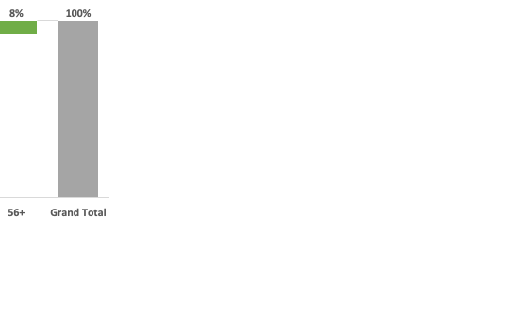
Data Insights
Geography
Gender
Age Group
Central geography is 50% of complete population, shows the zone is really doing well with marketing
More acquisition strategies need to be focused in other zone to improve.
There are 8 outliers for in this variable which is replaced by mode of the group i.e Male
The difference is quite significant between male and female population.
Age group between 25-45 constitutes almost 75% of the population , products are majorly owned by working professionals
Larger scope to target students and retired people
Note : Data analysis is conducted on whole population
Notes:
Photo by Clay Banks on Unsplash

Slide 4
Data Insights
Credit Score
Checking account
Digital status
Found 3 outliers in the data which are completely missing , replaced with the mean of the variable which is 603.
Need to target to acquire high credit score customers
71% of the population are under checking account which shows the customers are really active
BNA should work to move the non checking account customers to create a checking account
Digital customers are just 52% , great scope to push the customers to go digital which reduces a lot of manual effort and saves dollars
More IOT and digital tech teams to put efforts to improve better customer experience online
Note : Data analysis is conducted on whole population
Notes:
Photo by Clay Banks on Unsplash

Slide 5

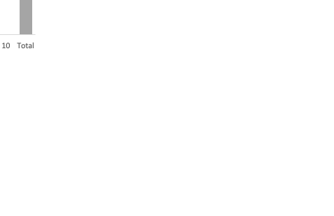
Data Insights
Estimated Salary
No of Products
Found an outlier with one customers with tenure as 30 Years replaced it to 10 years
Customers with 0 balance drive to almost 36% of total population.
Customers with 1 & 2 products contributes to 97% , marketing strategies to sell bundle products need to be given priority
Balance
Tenure
Note : Data analysis is conducted on whole population
Notes:
Photo by Campaign Creators on Unsplash

Slide 6


Random Forest Vs Gradient Boosting
Random Forest
Gradient Boosting
Random forests are a large number of trees, combined (using averages or “majority rules”) at the end of the process.
Bias error happens when you place too many restrictions on target functions
Random forests builds each tree independently
Random forests perform well for multi-clas, object detection and bioinformatics. which tends to have a lot of statistical noise.
Gradient boosting machines also combine decision trees, but start the combining process at the beginning, instead of at the end
Variance error refers to how much a result will change based on changes to the training set
Gradient boosting builds one tree at a time. This additive model (ensemble) works in a forward stage-wise manner, introducing a weak learner to improve the shortcomings of existing weak learners
Gradient Boosting performs well when you have unbalanced data such as in real time risk assessment.
If you carefully tune parameters, gradient boosting can result in better performance than random forests. However, gradient boosting may not be a good choice if you have a lot of noise, as it can result in overfitting. They also tend to be harder to tune than random forests
Notes:
Photo by Headway on Unsplash

Slide 7
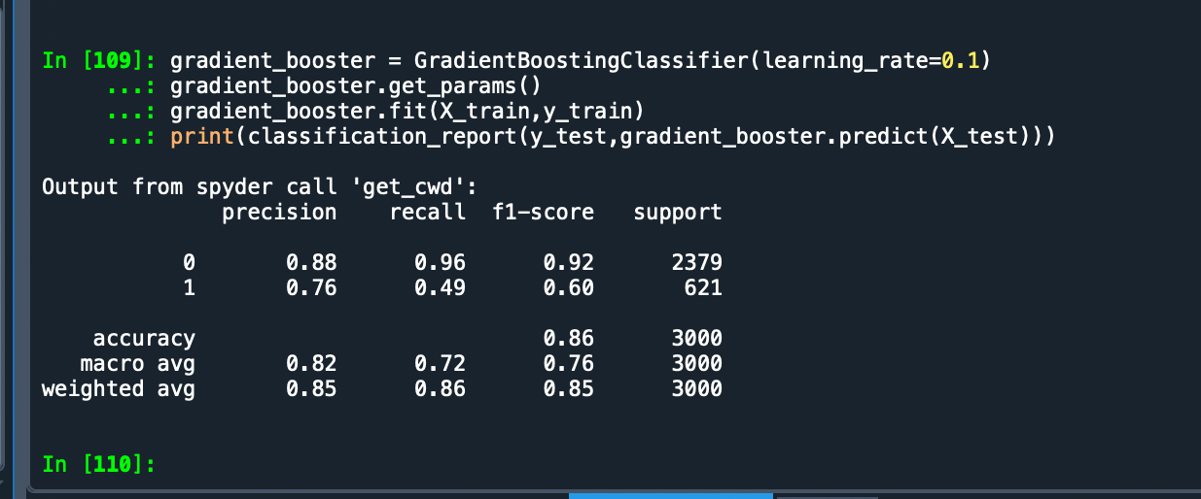
Model Prediction (Gradient boosting)
Output scores
Prediction Results
The results indicates Model accuracy is 86%
Used 3K customers to train the data and 7k customers to test the results
For every 100 customers we can successfully predict the 86 customers that going to churn or not accurately
Notes:
Photo by Carlos Muza on Unsplash

Slide 8
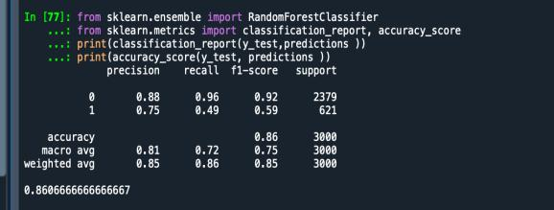
Model Prediction(Random Forest)
Output scores
Prediction Results
The results indicates Model accuracy is 86.06% (Random forest classifier )
Used 3K customers to train the data and 7k customers to test the results
For every 100 customers we can successfully predict the 86 customers that going to churn or not accurately
Notes:
Photo by Carlos Muza on Unsplash

Slide 9

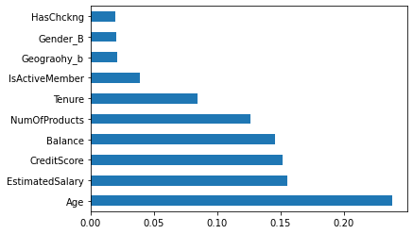
Conclusion
Based on this histogram, we can see that Age has the highest impact on customer churn, followed by a customer's estimated salary, credit score and account balance.
Prediction of Customer churn is crucial to the long term financial stability, this model is able to predict customer churn with an accuracy of 86.06%
Notes:
Photo by Headway on Unsplash

Slide 10

THANK YOU
Notes:
Photo by Dylan Gillis on Unsplash

